Slide 1
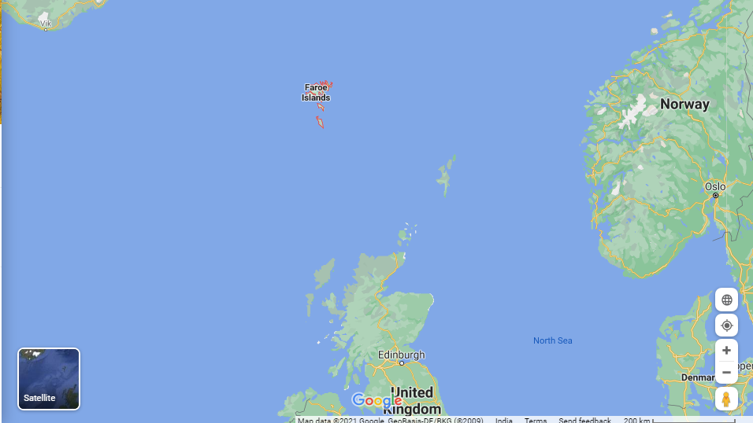
Faroe Islands from Toursim point of view
Archipelago of 18 islands, north of UK between Iceland and Norway in Atlantic Ocean having almost 50000 inhabitants
Capital - Torshavn

Slide 2
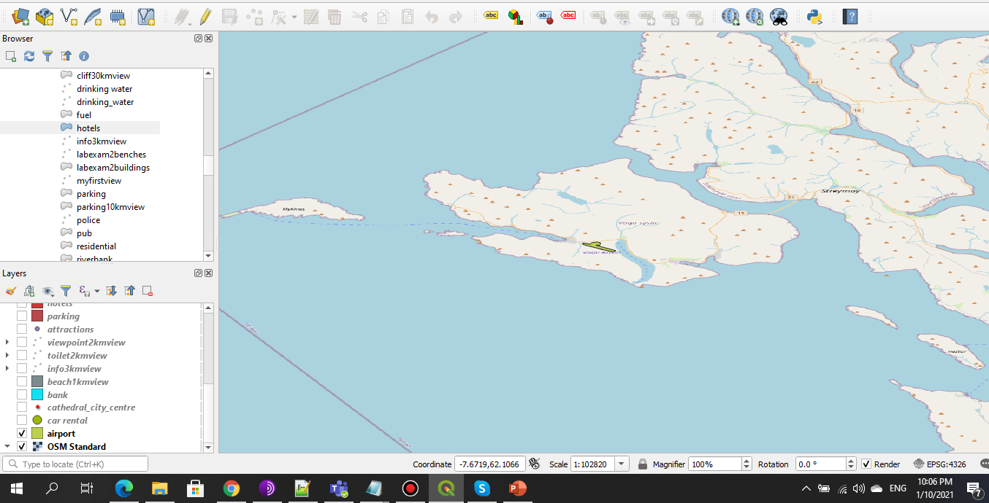
Vagator Airport- Faroe Islands

Slide 3
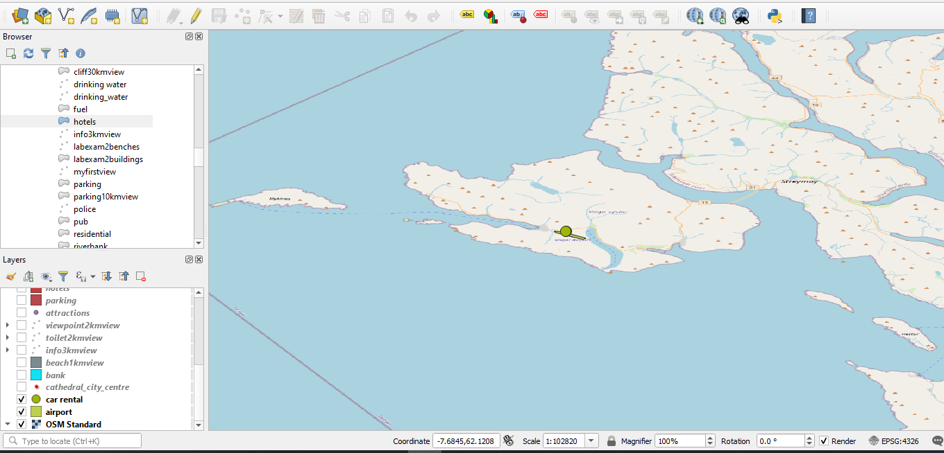
Airport and Car Rental

Slide 4
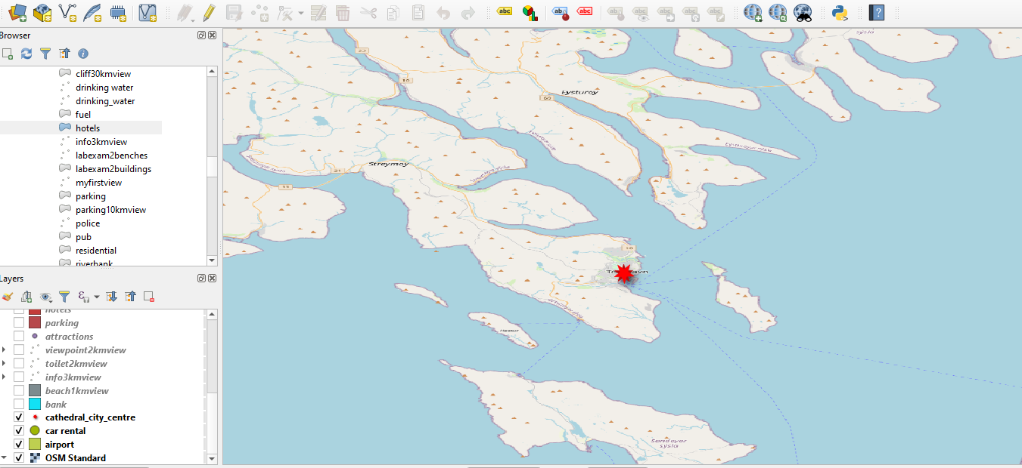
City Centre – Torshavn(Capital)

Slide 5
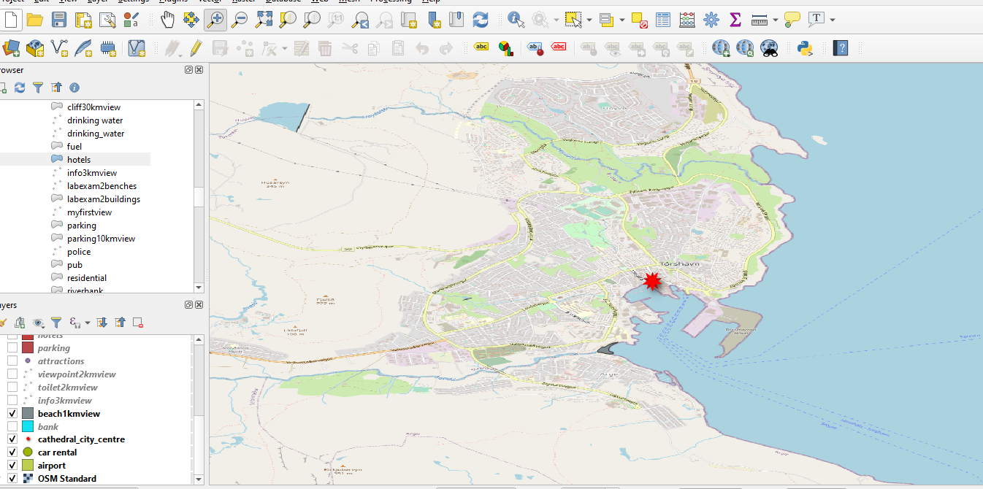
Beach within 1km view, let’s go for Jogging

Slide 6
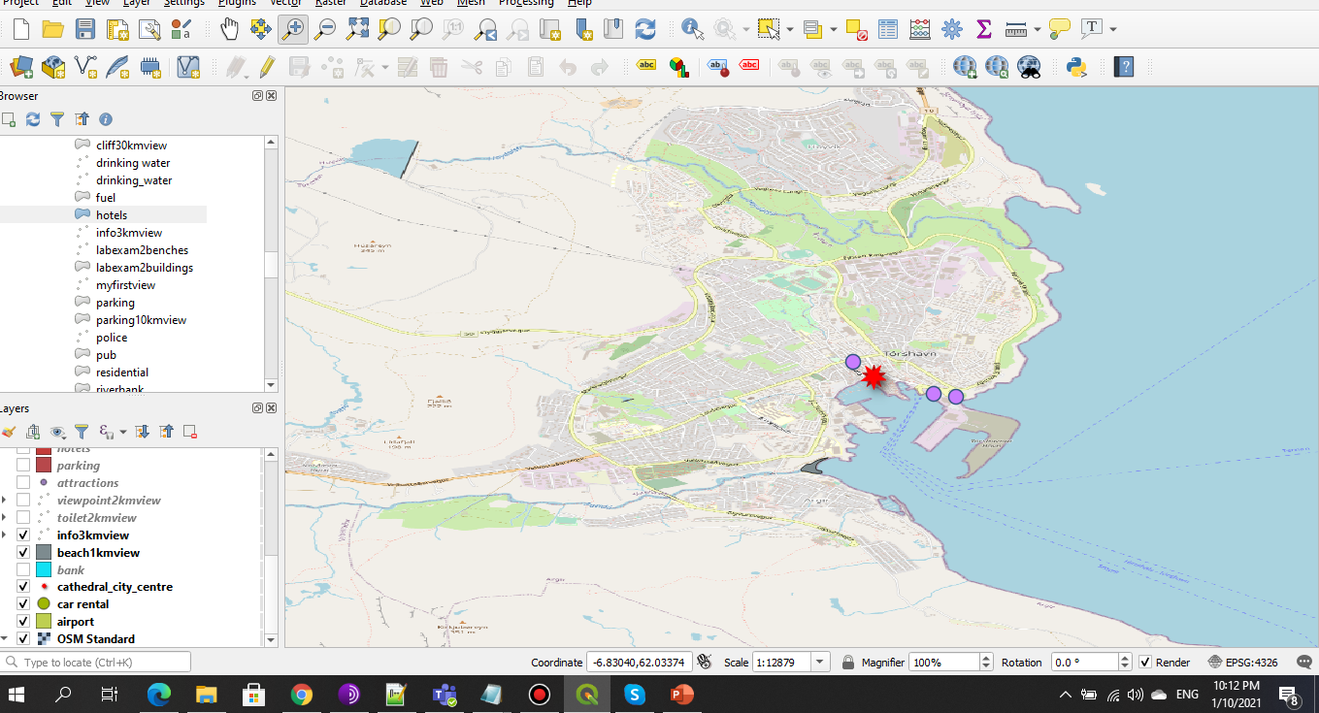
Tourist information center within 1km view

Slide 7
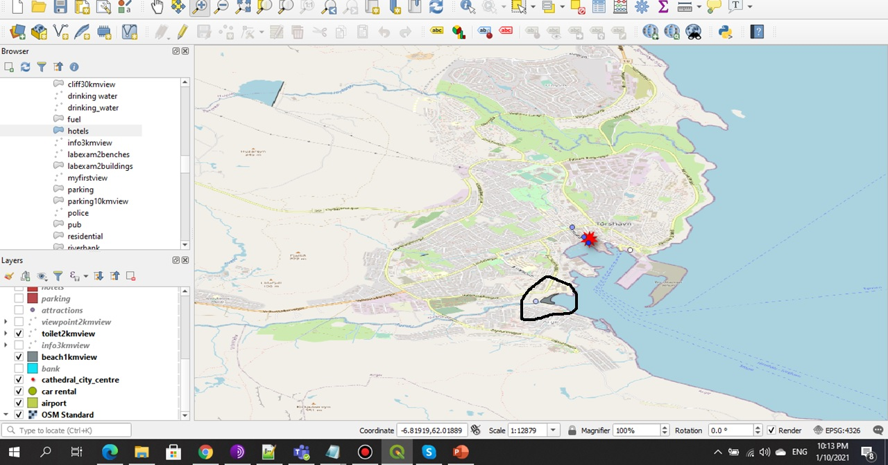
Toilets within 2km, notice toilet on beach, Yay!!

Slide 8
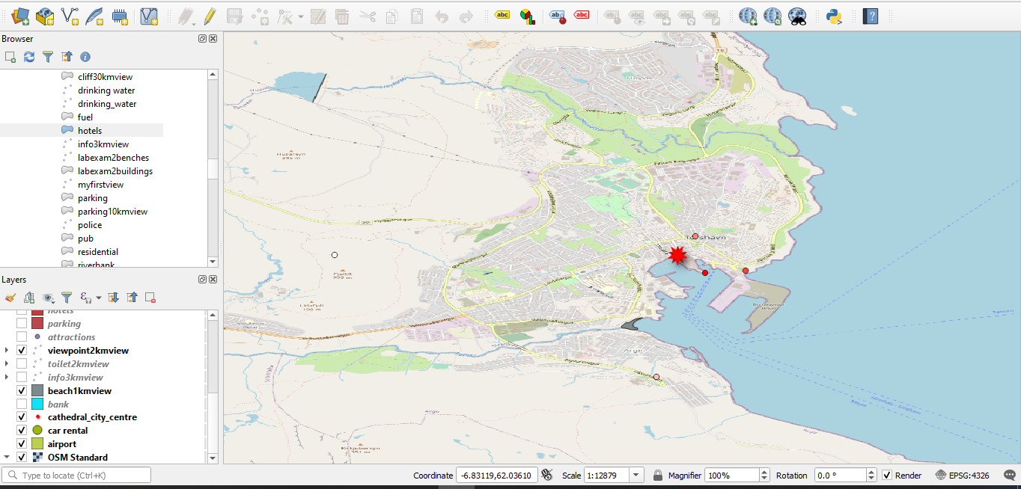
Viewpoint within 2km, let’s cover by walking

Slide 9
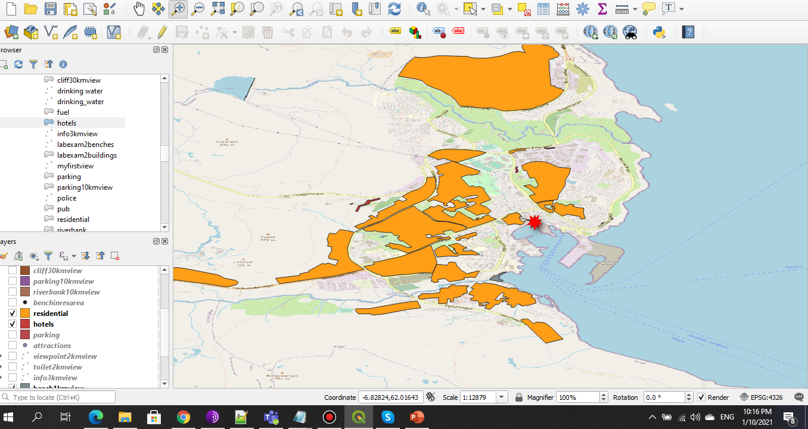
Hotels and Residential area polygons

Slide 10
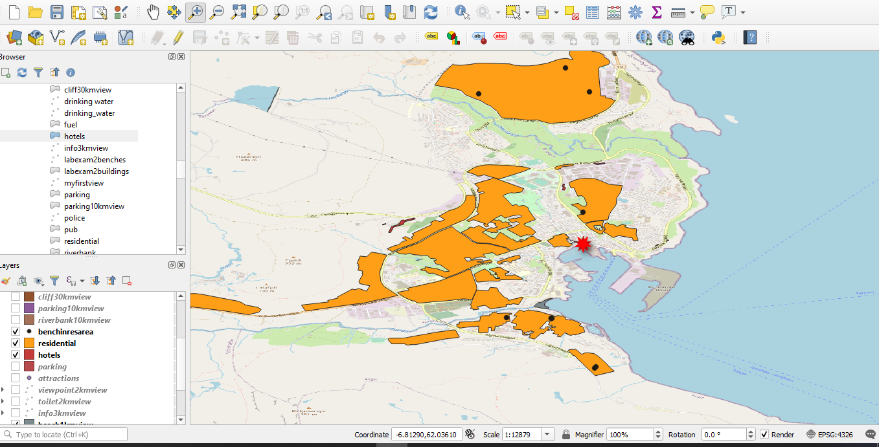
Benches in Residential Area using ST_Contains(Area(Polygons), Benches(Points))

Slide 11
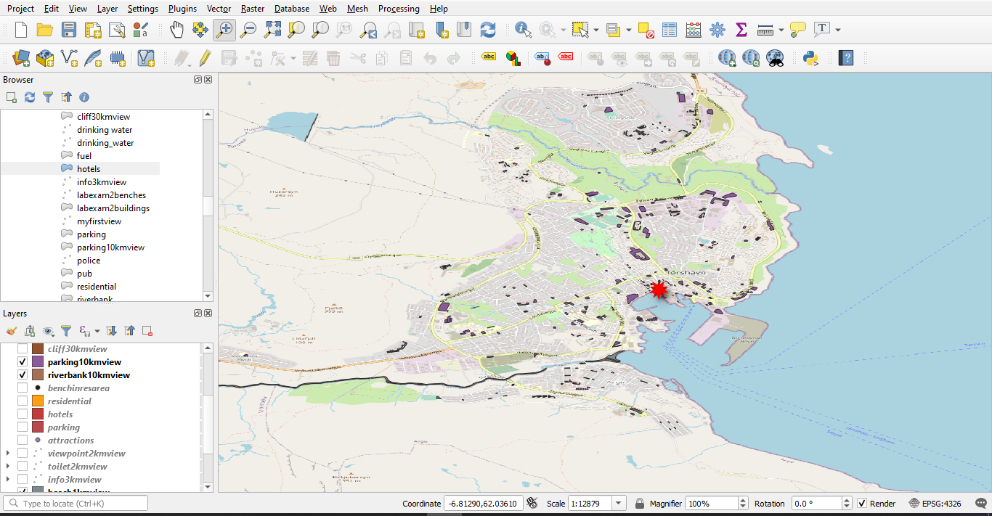
Parking and riverbank view

Slide 12
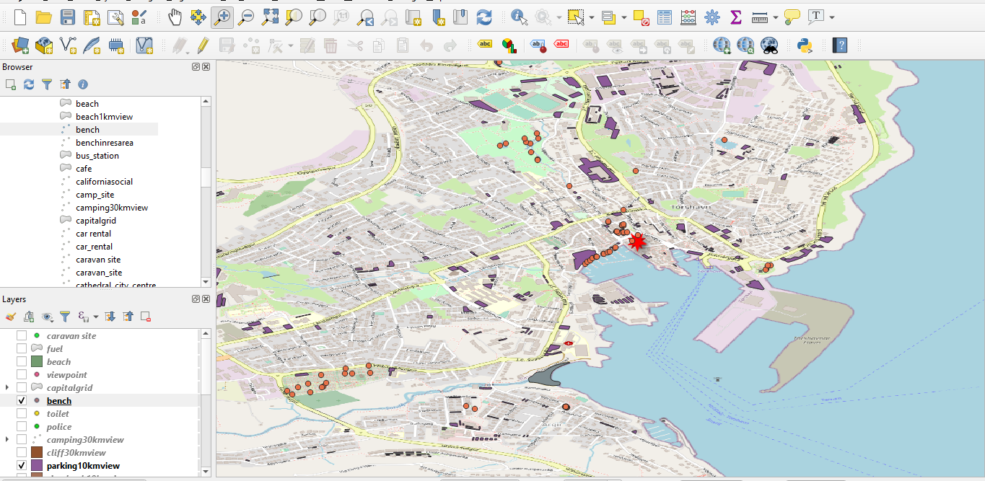
Benches and Parking within 10km

Slide 13
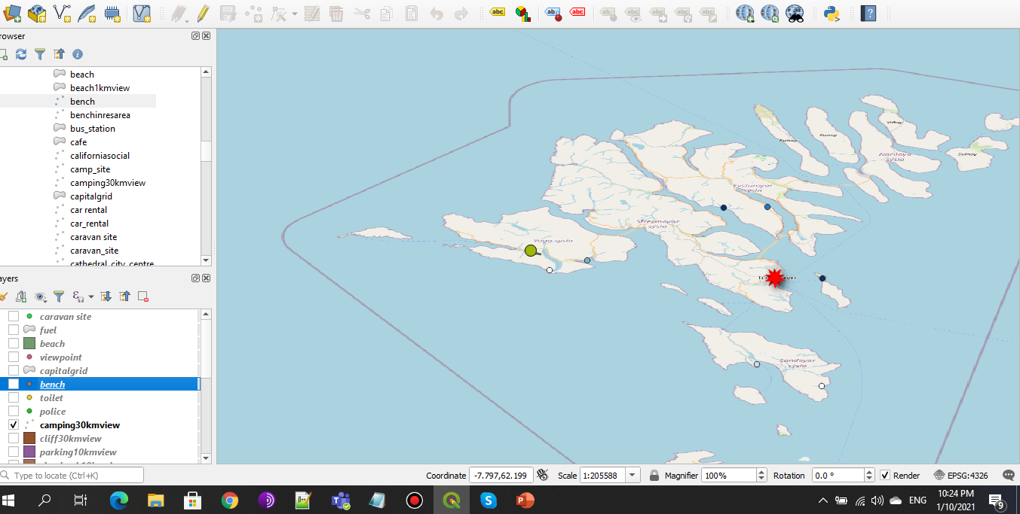
Camping sites within 30km

Slide 14
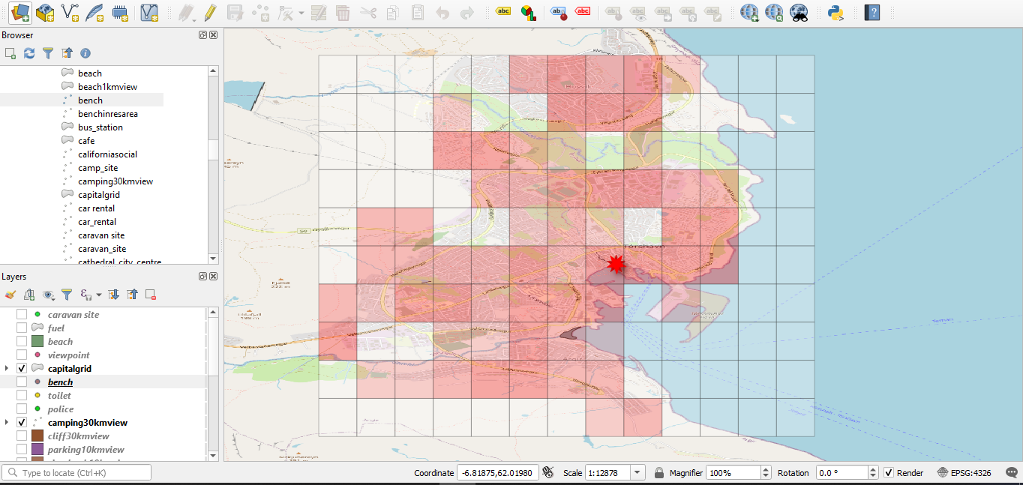
Chloropleth or Heat Map of Capital based on No of hotels and parkings

Slide 15
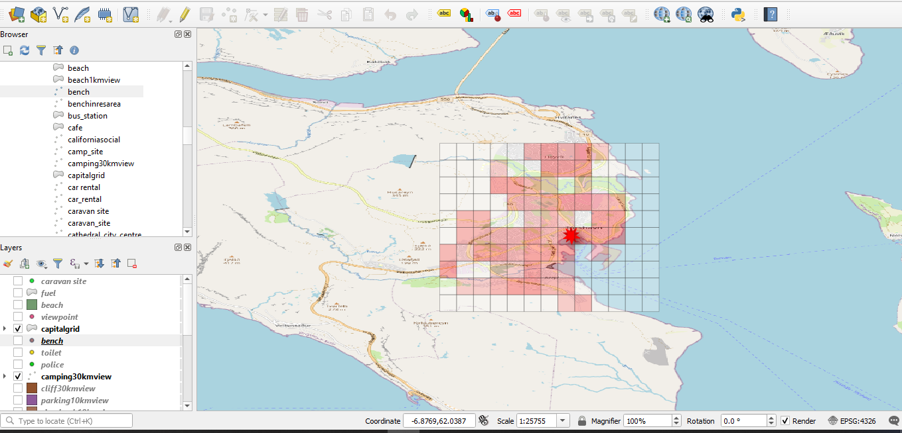
We can see ocean and outskirts is having transparent color as there are no hotels and parking

Slide 16
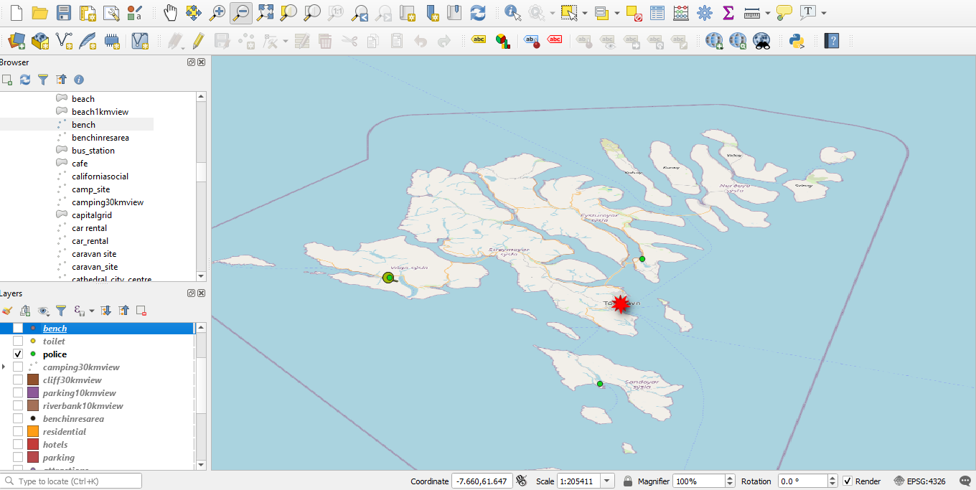
Only 3 police stations, that means crime rate is negligible*0.000000001 = almost zero.

Slide 17
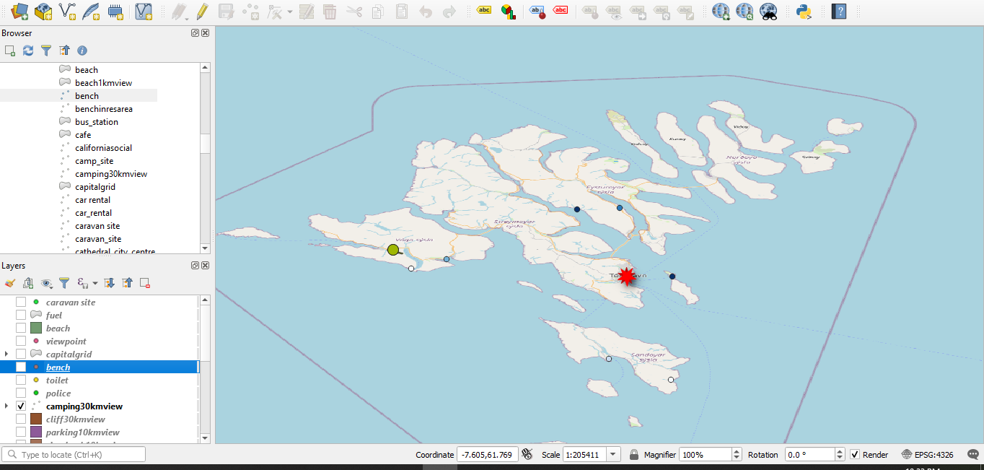
Camping sites, yeah!!

Slide 18
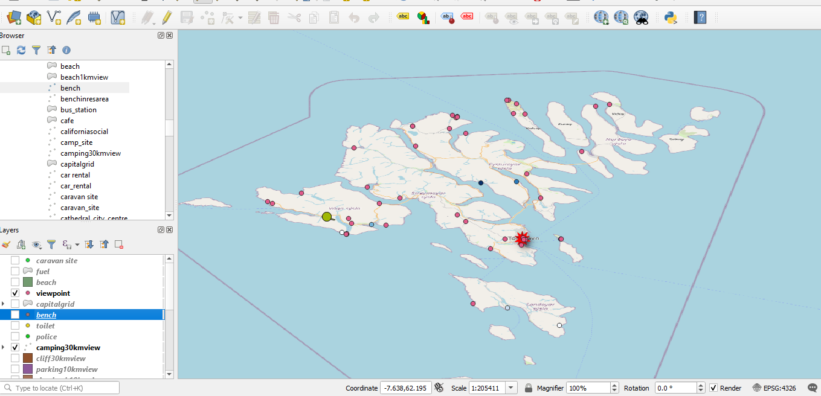
So many viewpoints, perfect destination

Slide 19
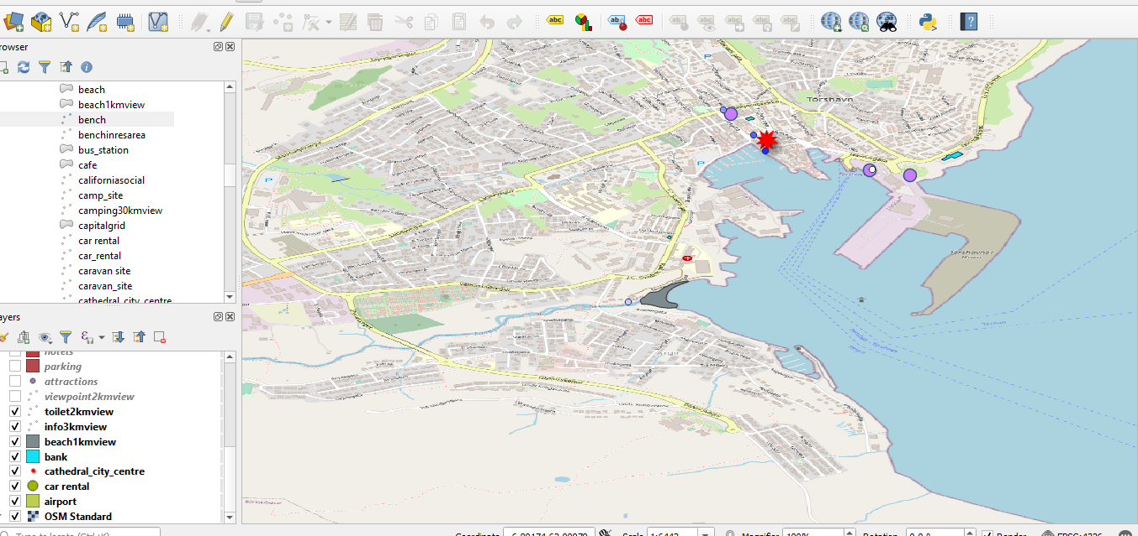
Lots of tourist_centres, toilets, banks and beaches at a walking distance.

Slide 20
Faroe islands is a perfect getaway as there are lots of viewpoints, cliffs and having almost every facility like toilets, parkings, information centrers etc.
Challenges – Limited Polygon as well as points data(like banks, atms, rail_stations)
due to its low population(almost 50000)

Slide 21
Thank You

